Slide 1
Building Bioinformatics Workflows with Snakemake
Sanjana Kulkarni
BST 281 Guest Lecture
April 30, 2025

Slide 2
About
4th year PhD student in Maha Farhat’s lab (Department of Biomedical Informatics)
I research Mycobacterium tuberculosis using bioinformatics, statistics, and machine learning.
BST 281 student in Spring 2022, TF in Spring 2023

Slide 3
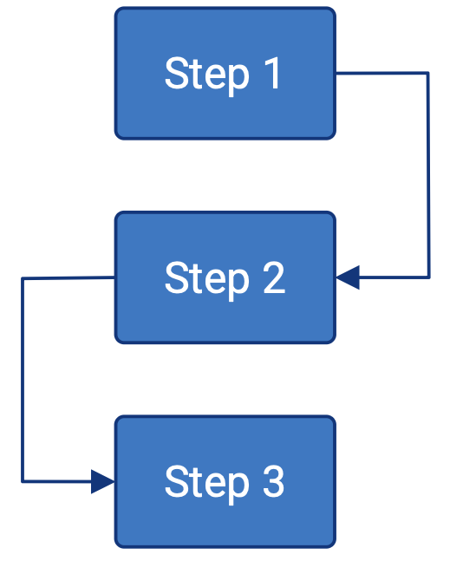
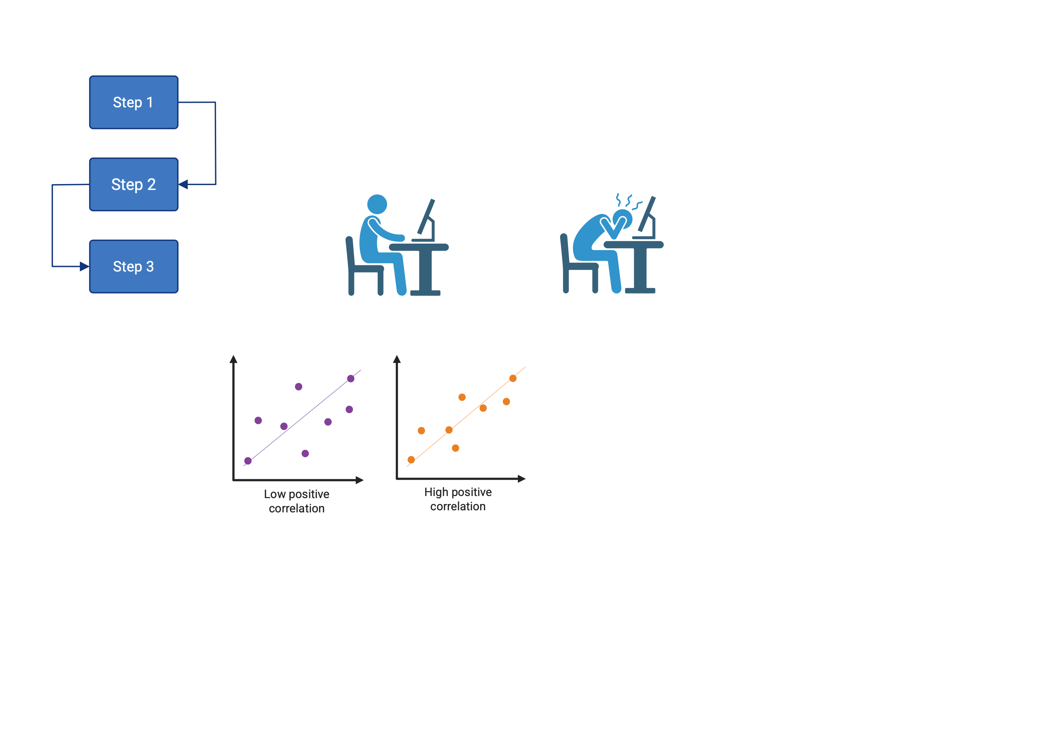
Bioinformatics workflows need to be EASY to rerun and share
README:
Run 01_first_script.py
Run 02_second_script.py
Run 03_third_script.sh
Visual representation of the steps is easy to share with others
Overhead to write the workflow at the outset…
saves you time when you rerun your analyses with minor changes.
Notes:
1) it's better than just writing down what you did since it can actually do the work.
2) It's better than step1.sh, step2.sh, etc. since it can be rerun with minimal effort.
3) It's efficient and will only rerun the steps where the inputs actually changed, e.g. if you're just changing the plot at the end, or trying a more stringent FDR threshold requested by a reviewer.
4) 95% of the time the "reproducibility" will be by YOU, the creator of the workflow, either running with small changes (as in my #3 examples) or running the same work on new data

Slide 4
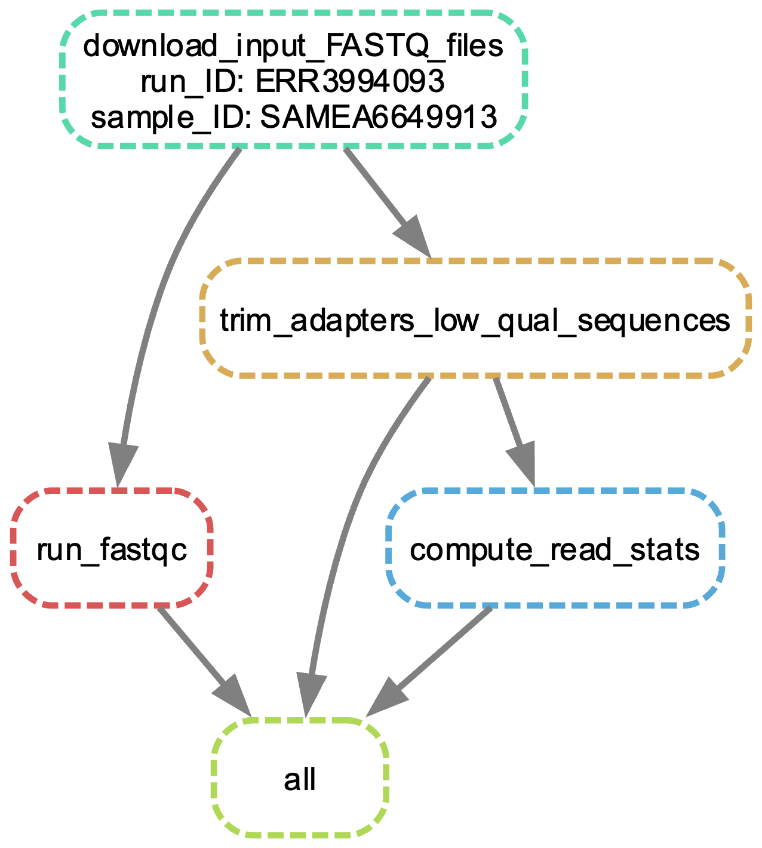
Directed Acyclic Graph of Steps

Slide 5




Slide 6
Workflow languages allow you to build scalable, reproducible, modular workflows
Step 1:
Parameters
Software
Input 1
Output 1
Input 2
Step 2:
Parameters
Software
Output 1
Final Output

Slide 7
Workflows will only rerun steps that changed
Step 1:
Parameters
Software
Input 1
Output 1
Input 2
Parallelization of steps
Efficient resource allocation
Error handling
Step 2:
Parameters
Software
Output 1
Final Output

Slide 8
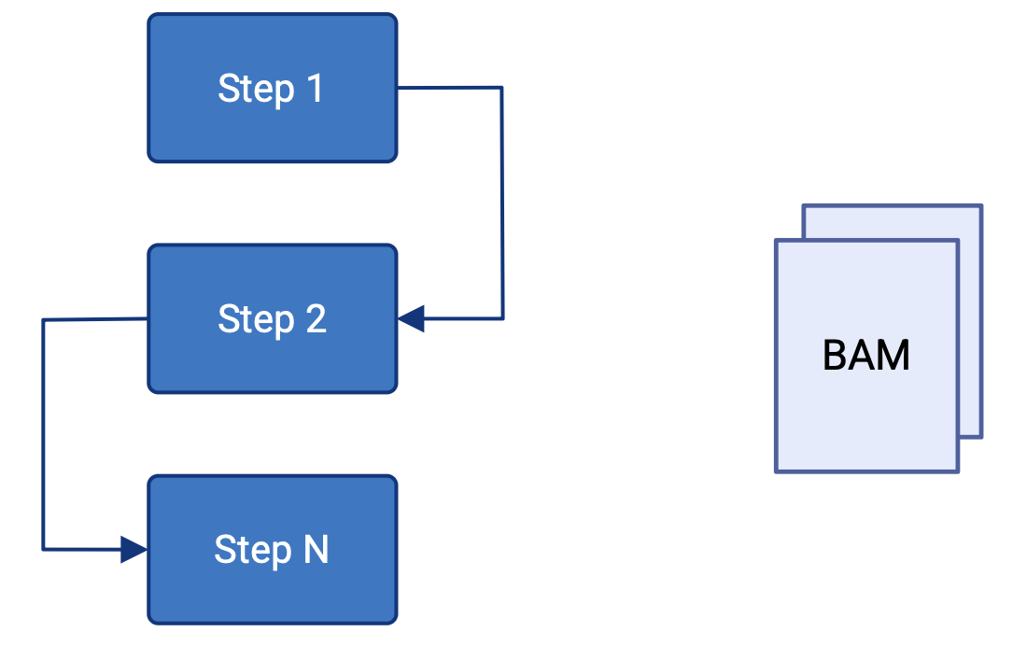
How to build a workflow
…
Steps
Output

Slide 9
How to build a workflow in Snakemake: Rules
rule my_rule:
input:
fName1 = “path/to/inputfile”,
fName2 = “path/to/other/inputfile”,
output:
output1 = “path/to/output/file”,
output2 = “path/to/output/file”,
params:
threshold_val = 10,
conda:
“envs/my_env.yaml”
shell:
"""
some_command {input.fName1} {output.output1} -p {params.threshold_val}
some_command {input.fName2} {output.output2} -p {params.threshold_val}
"""
Input and output files
Additional parameters
Conda environment
Inputs, outputs, and params are accessible like so

Slide 10
Because Snakemake is python-based, you can run python commands
rule my_python_rule:
input:
fName1 = “path/to/inputfile”,
fName2 = “path/to/other/inputfile”,
output:
output1 = “path/to/output/file”,
output2 = “path/to/output/file”,
params:
threshold_val = 10,
run:
print(f"Filename 1: {input.fName1}, Filename 2: {input.fName2}")

Slide 11
How to build a workflow
…
Steps
Output

Slide 12
How to build a workflow in Snakemake: Snakefile
include: "rules.smk”
rule all:
input:
“output_file_1.txt”,
“output_file_2.txt”
Rules file(s) with steps
Output files of the full workflow
Snakemake figures out all the steps to run in order to create the desired outputs.

Slide 13
Snakefile: Passing in a list of samples
Can access installed Python packages as you would in a script
import pandas as pd
# config is a global dictionary created from the config file specified on the command line
output_dir = config[“output_dir”]
# read in a CSV file of samples
df_samples = pd.read_csv(config[“isolates_to_run”])
samples_lst = df_samples[“Sample”].values
Read in a CSV of samples

Slide 14
Snakefile: Passing in a list of samples
Can access installed Python packages as you would in a script
import pandas as pd
# config is a global dictionary created from the config file specified on the command line
output_dir = config[“output_dir”]
# read in a CSV file of samples
df_samples = pd.read_csv(config[“isolates_to_run”])
samples_lst = df_samples[“Sample”].values
include: "rules.smk”
rule all:
input:
[f”{output_dir}/{sample}/output_file_1.txt” for sample in samples_lst],
[f”{output_dir}/{sample}/output_file_2.txt” for sample in samples_lst],
Read in a CSV of samples
Use list comprehensions to list the output files for multiple samples

Slide 15
Activity

Slide 16
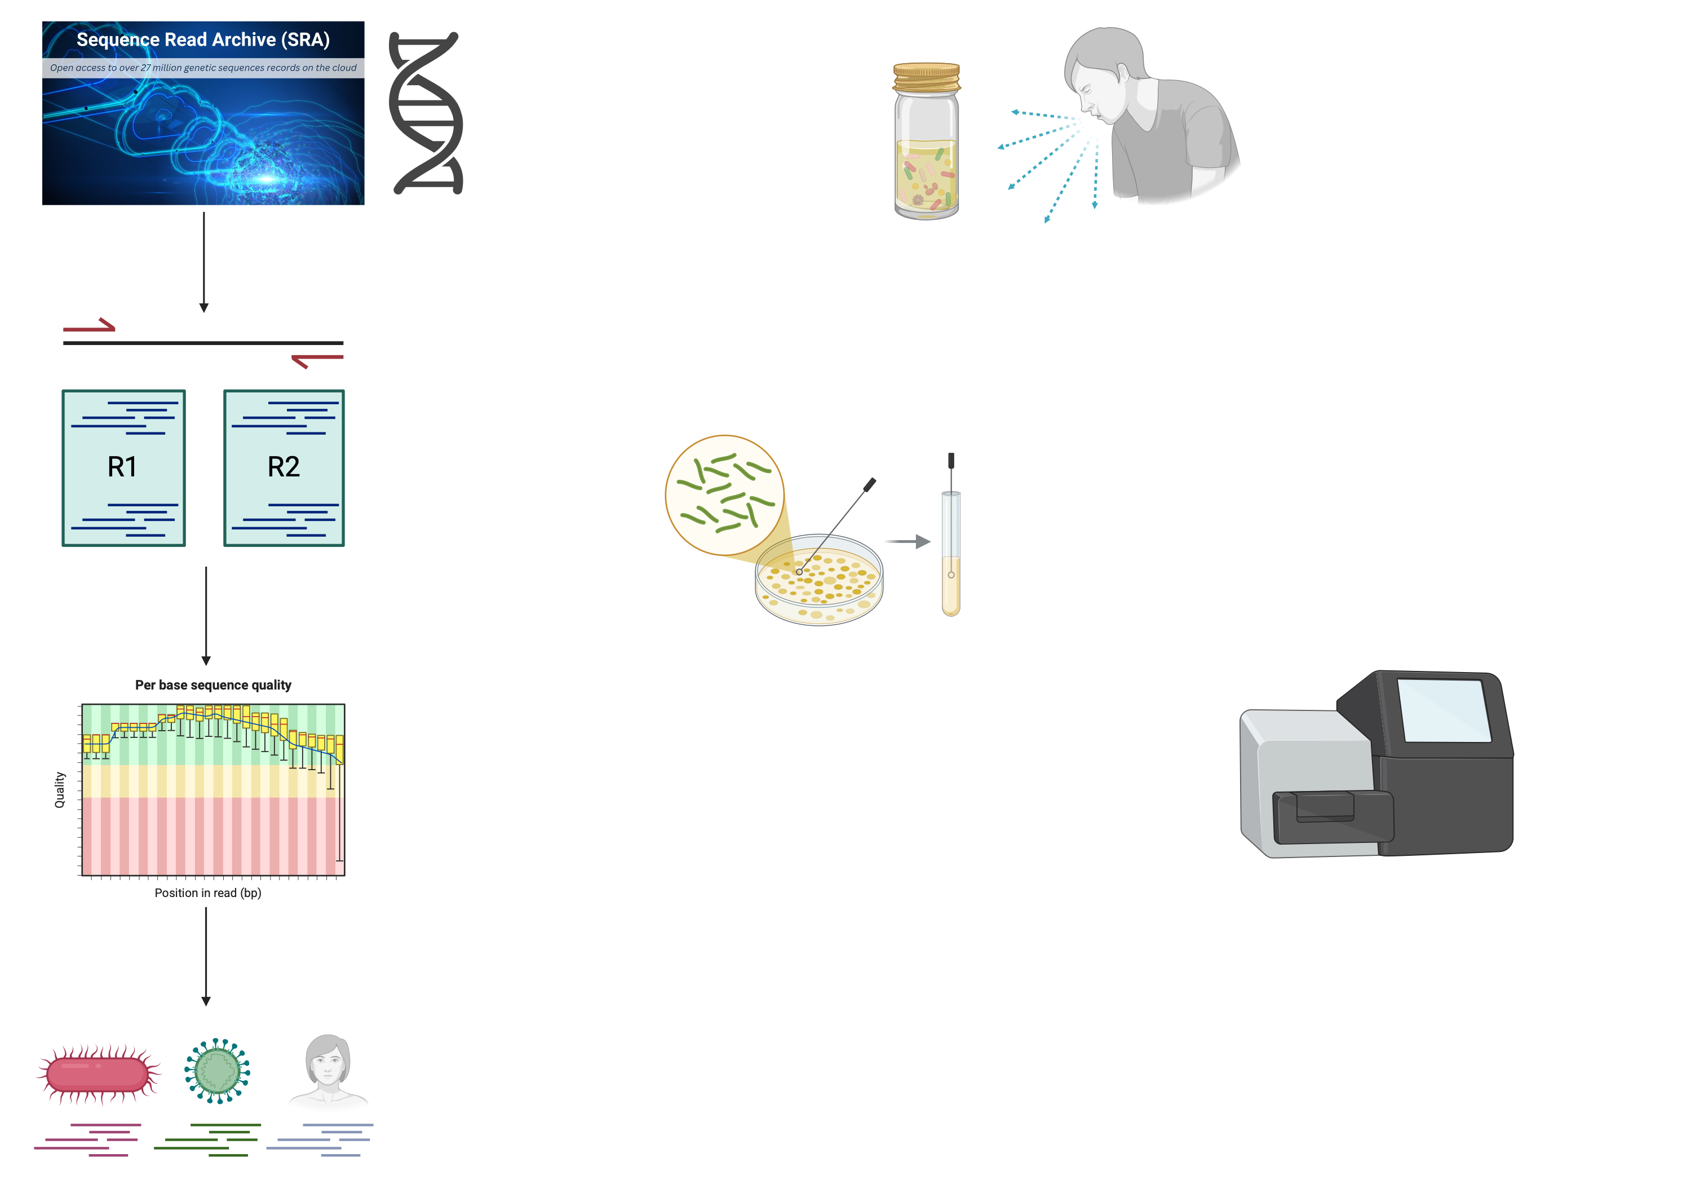
Short background on whole-genome sequencing for M. tuberculosis
Collect sputum sample from symptomatic patient
Culture mycobacteria to
Enrich mycobacterial DNA
Screen out contaminants
Whole-genome sequencing

Slide 17
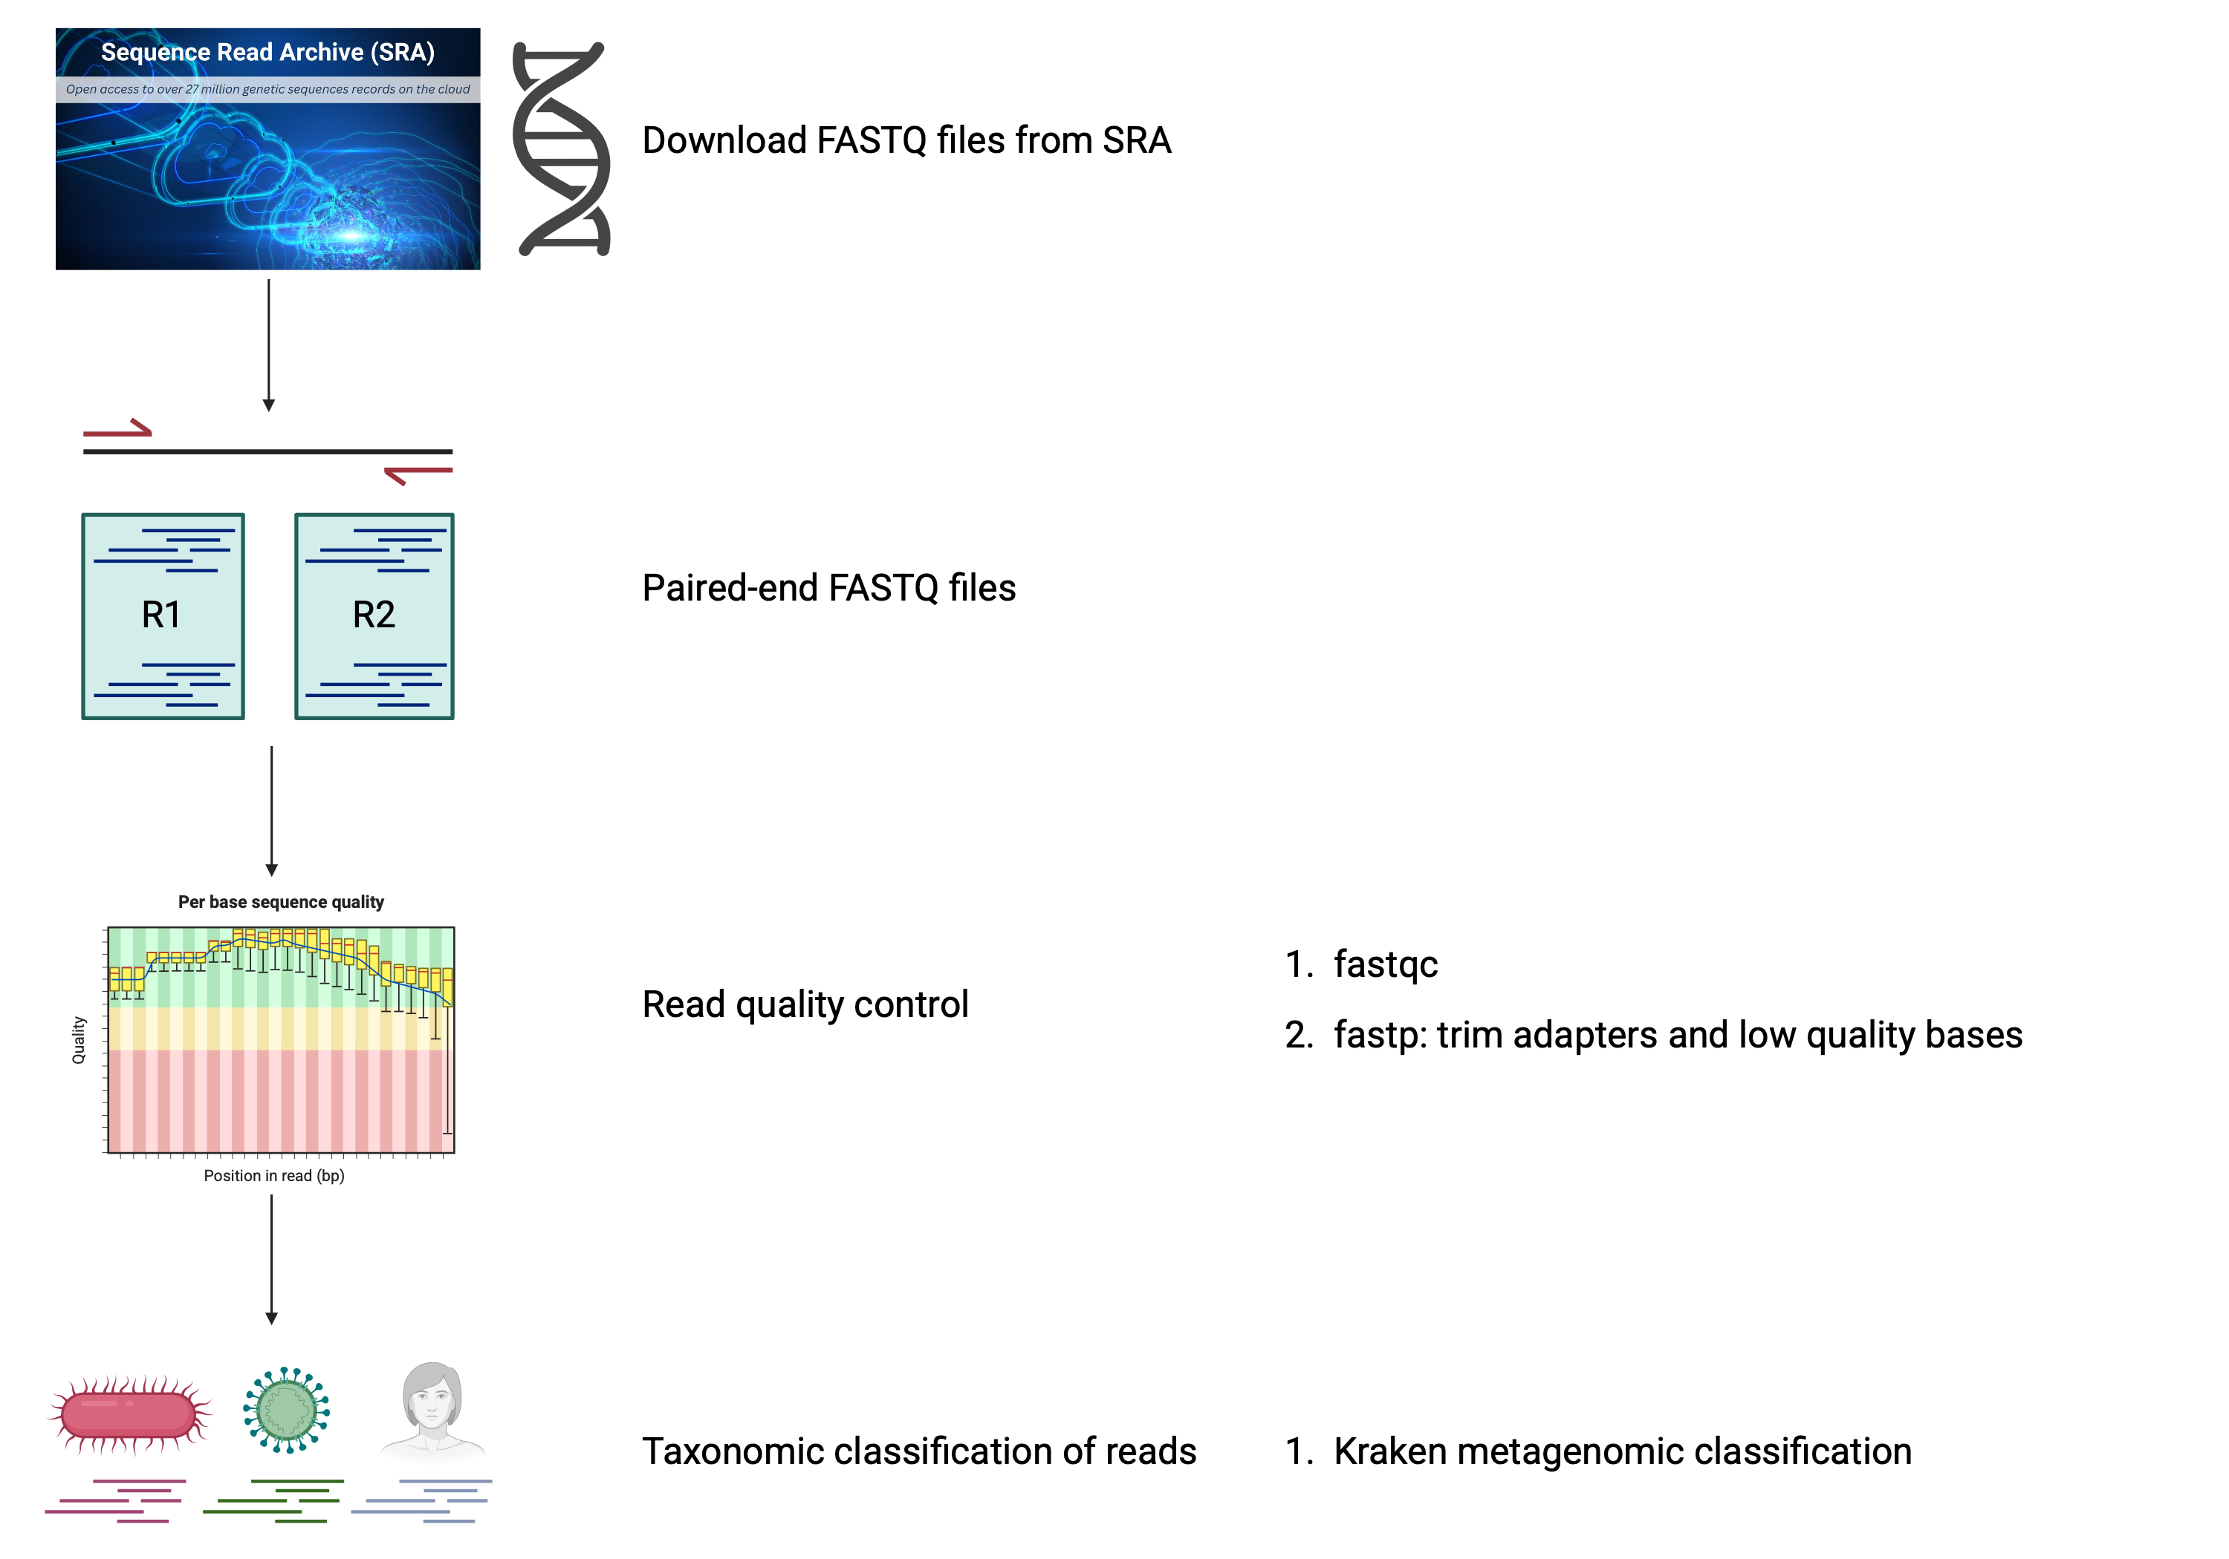
1
2
Download short-read FASTQs from SRA
Samples were sequenced by paired-end, so there are 2 read files for each isolate.
3
4
Taxonomic classification and contaminant removal

Slide 18
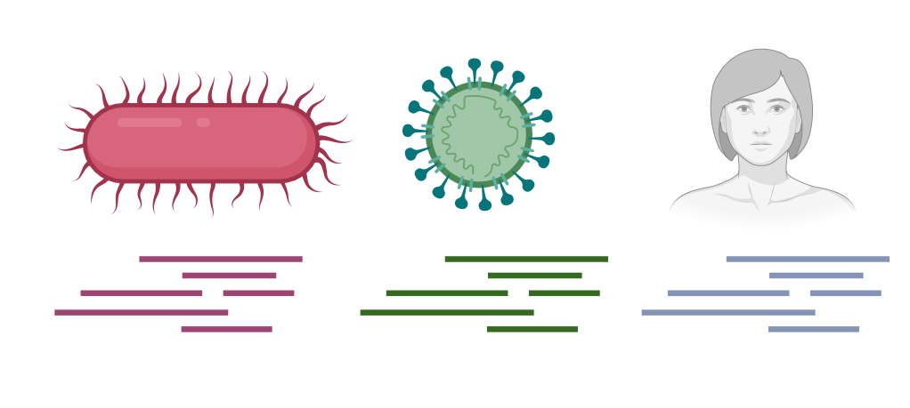
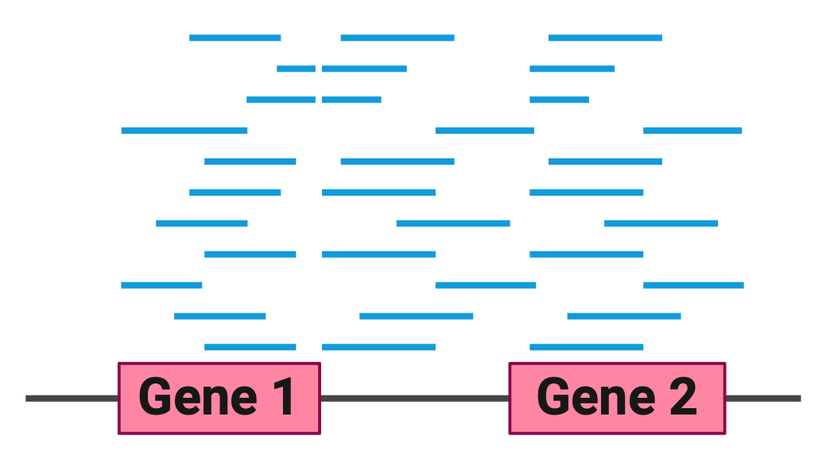

Kraken Tools match k-mers to a database to classify individual reads
Kingdom | Relative Abundance
Eukaryota | 25%
Bacteria | 65%
Viruses | 10%
Taxonomic Classification
Read extraction
Relative Abundance Estimation
Standard Kraken database uses 35-mers
Map reads to a reference
Metagenome analysis using the Kraken software suite, Nature Protocols, 2022

Slide 19
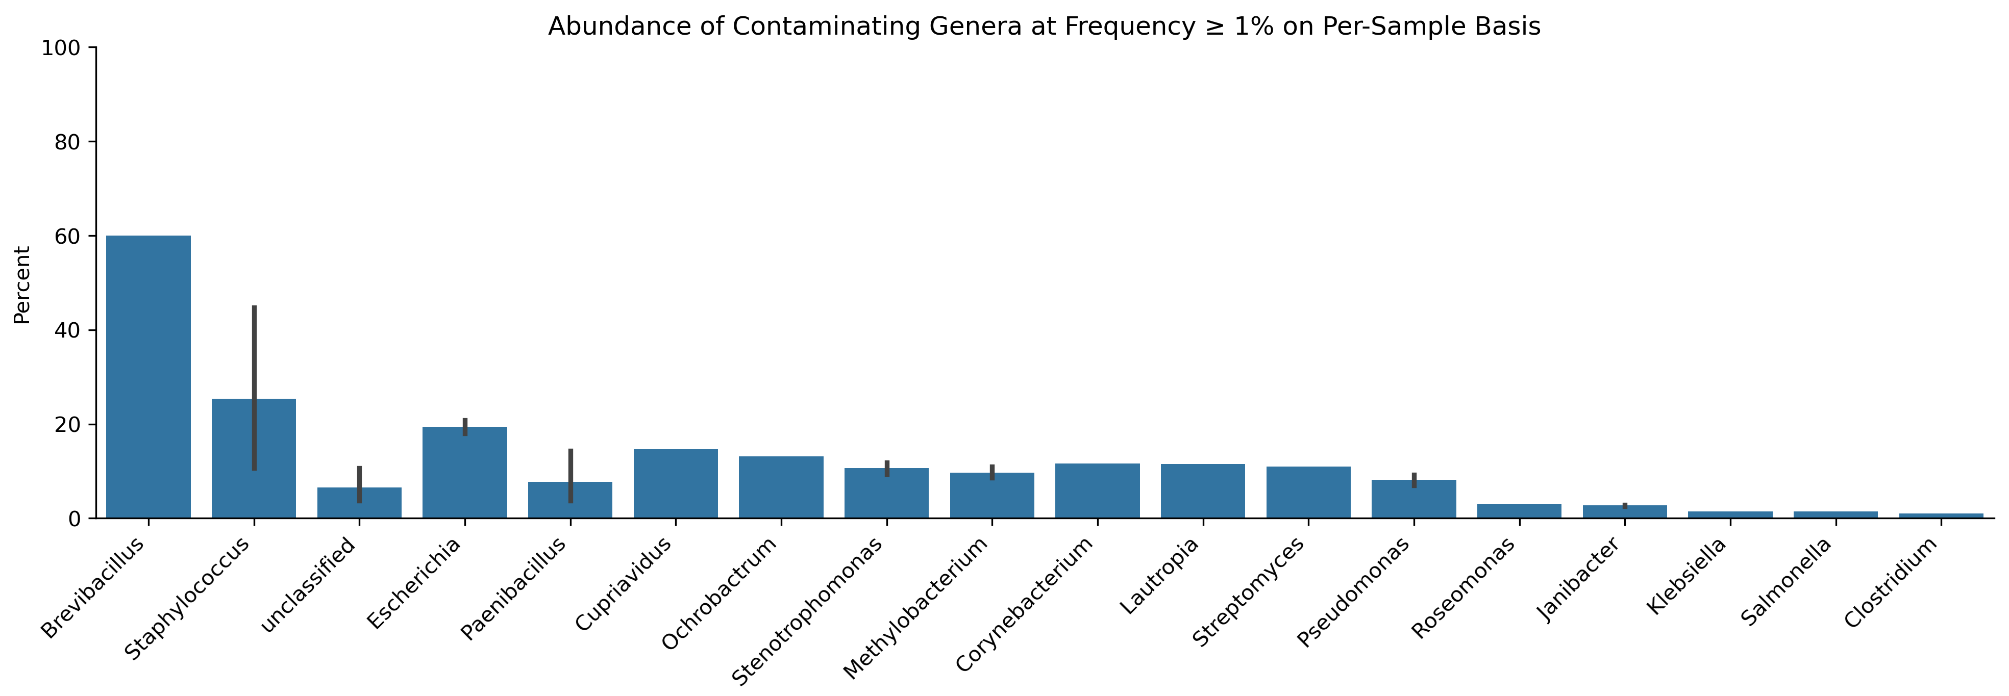
Most common contaminants among 12,000 M. tb samples

Slide 20
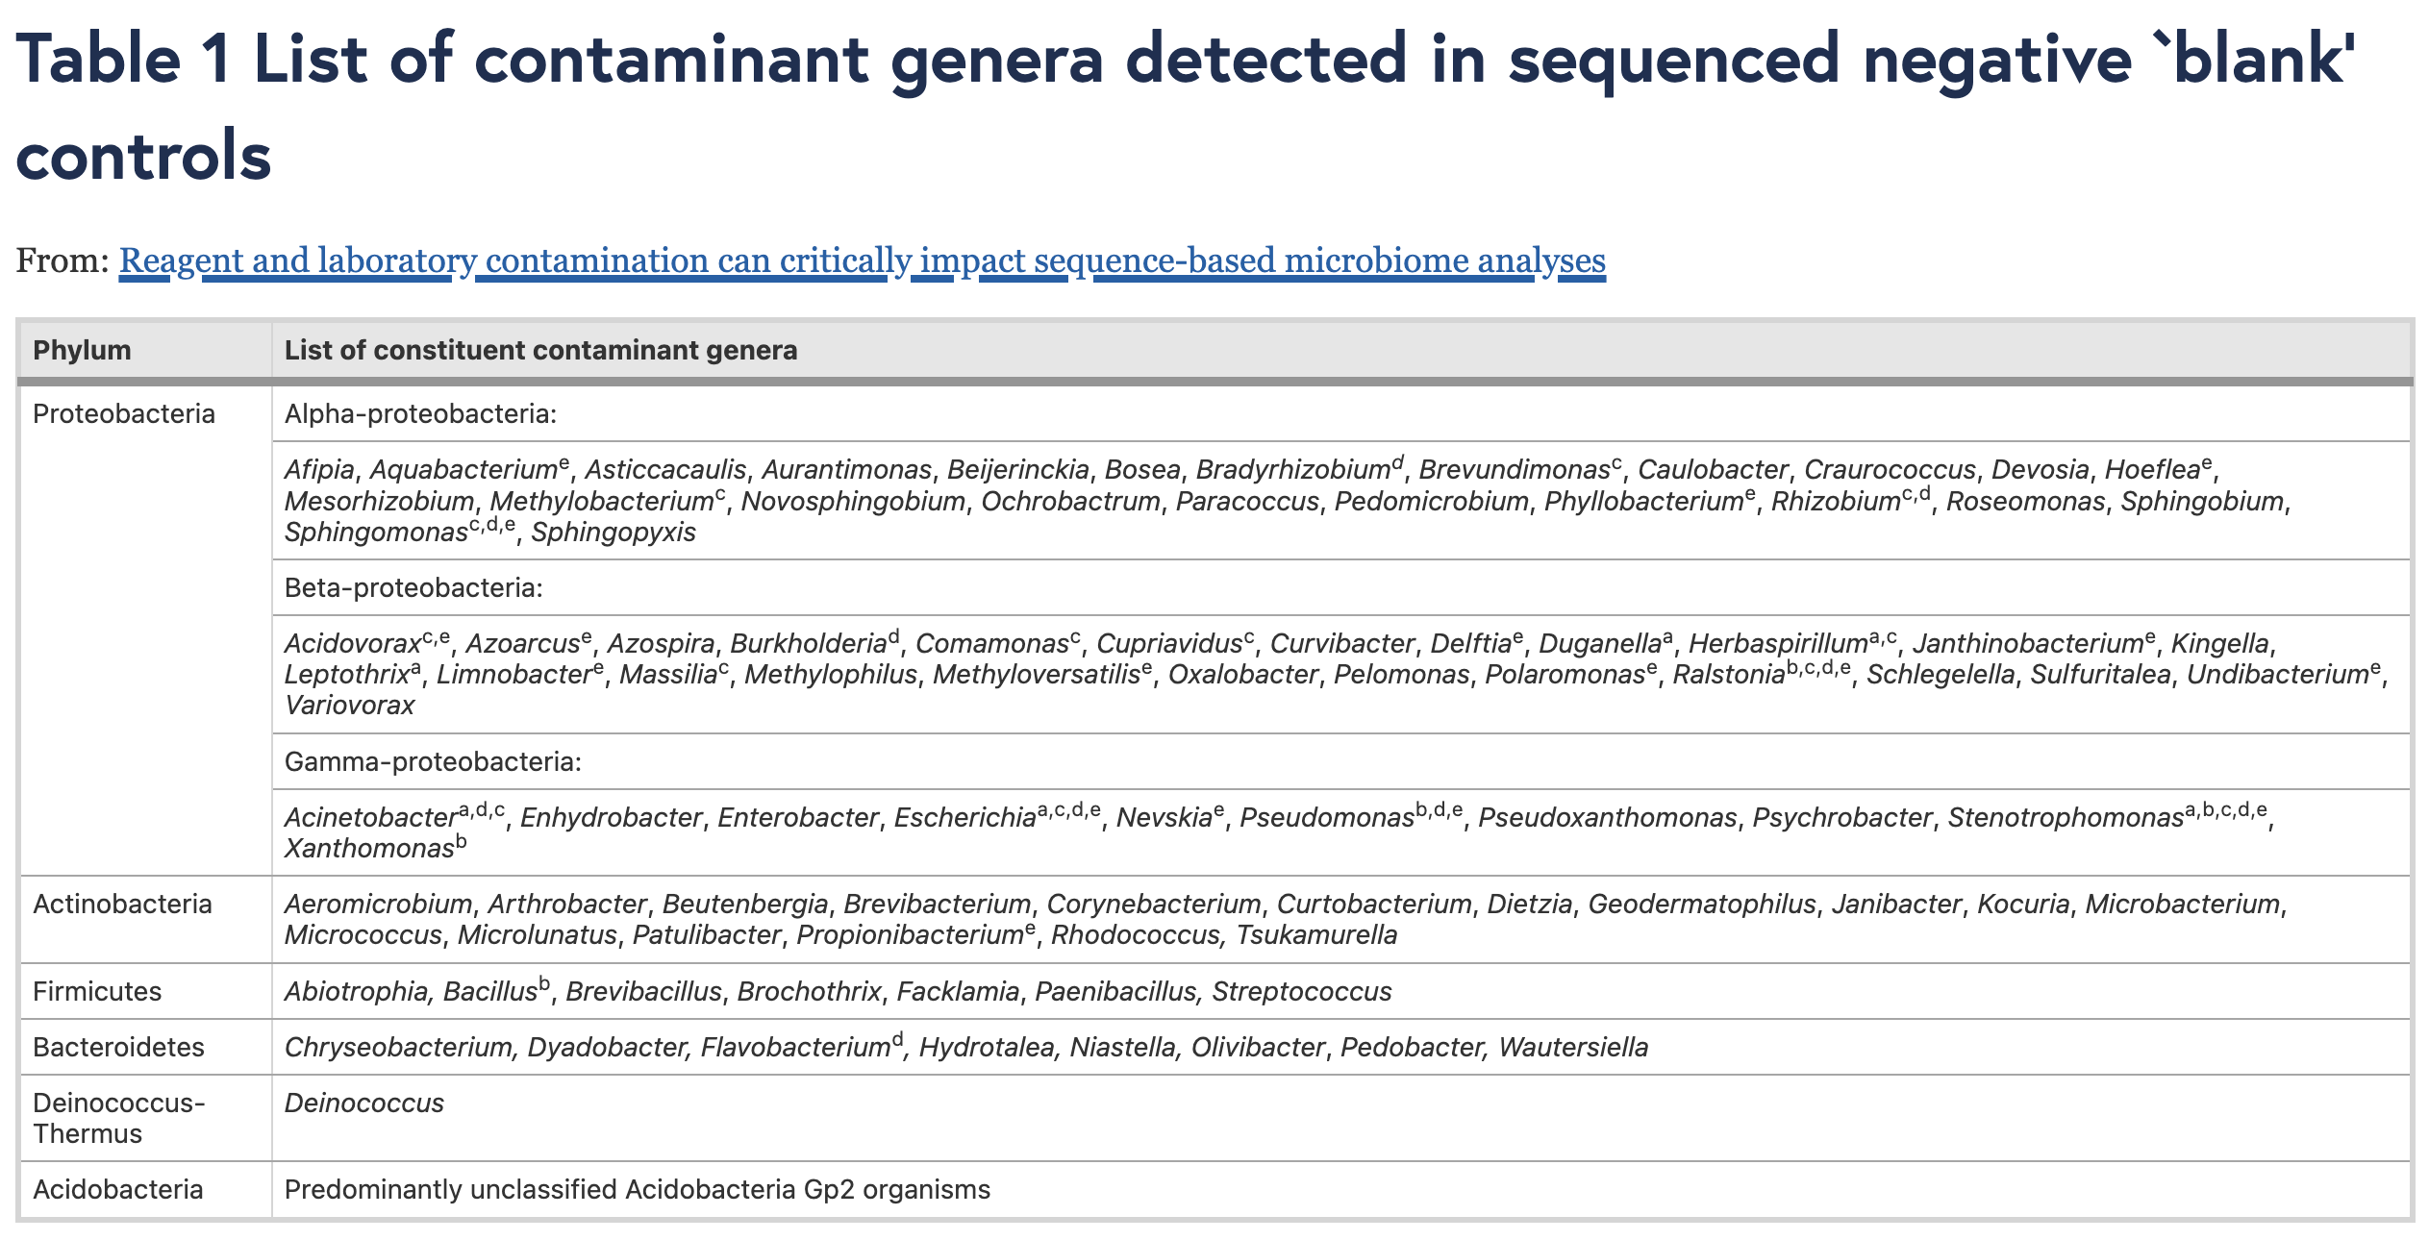











DNA extraction kits contaminated with soil- and water-dwelling bacteria
(PCR and 16S rRNA sequencing of ultrapure water)
Salter, S.J., Cox, M.J., Turek, E.M. et al. Reagent and laboratory contamination can critically impact sequence-based microbiome analyses. BMC Biol 12, 87 (2014). https://doi.org/10.1186/s12915-014-0087-z

Slide 21
Workflow Steps

Slide 22
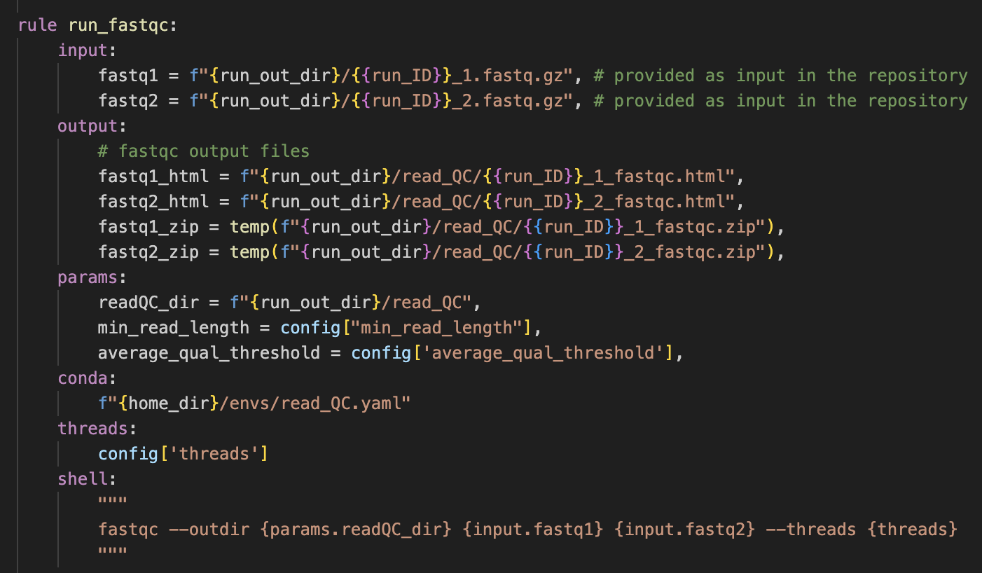
1. Run fastqc to get QC metrics on the original FASTQ files
Mark files for removal if they are temporary

Slide 23
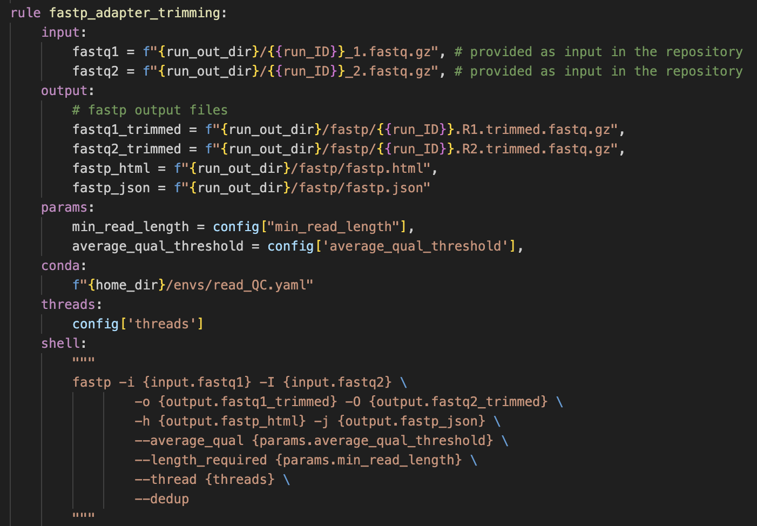
2. Run fastp to trim adapters and drop low-quality or short reads

Slide 24
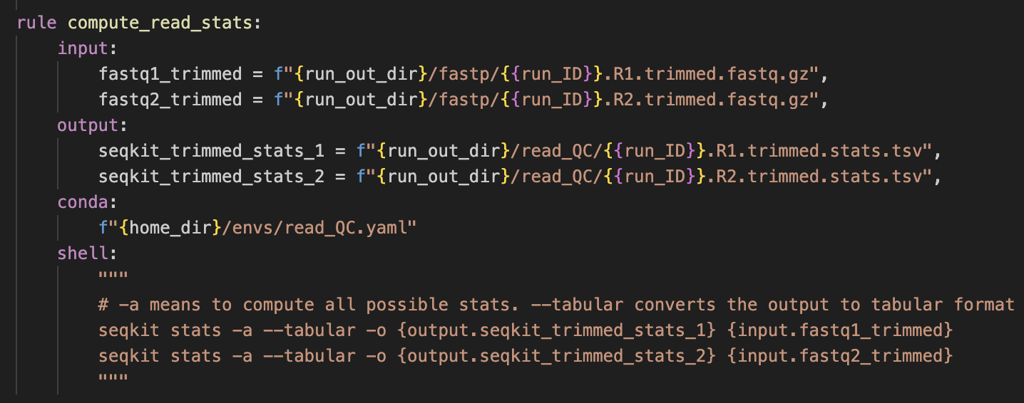
3. Compute global read statistics in tabular format

Slide 25
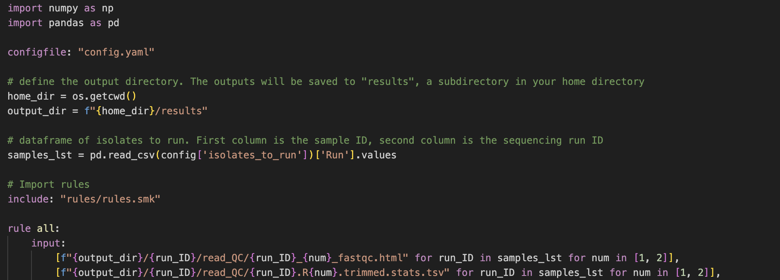
Snakefile

Slide 26
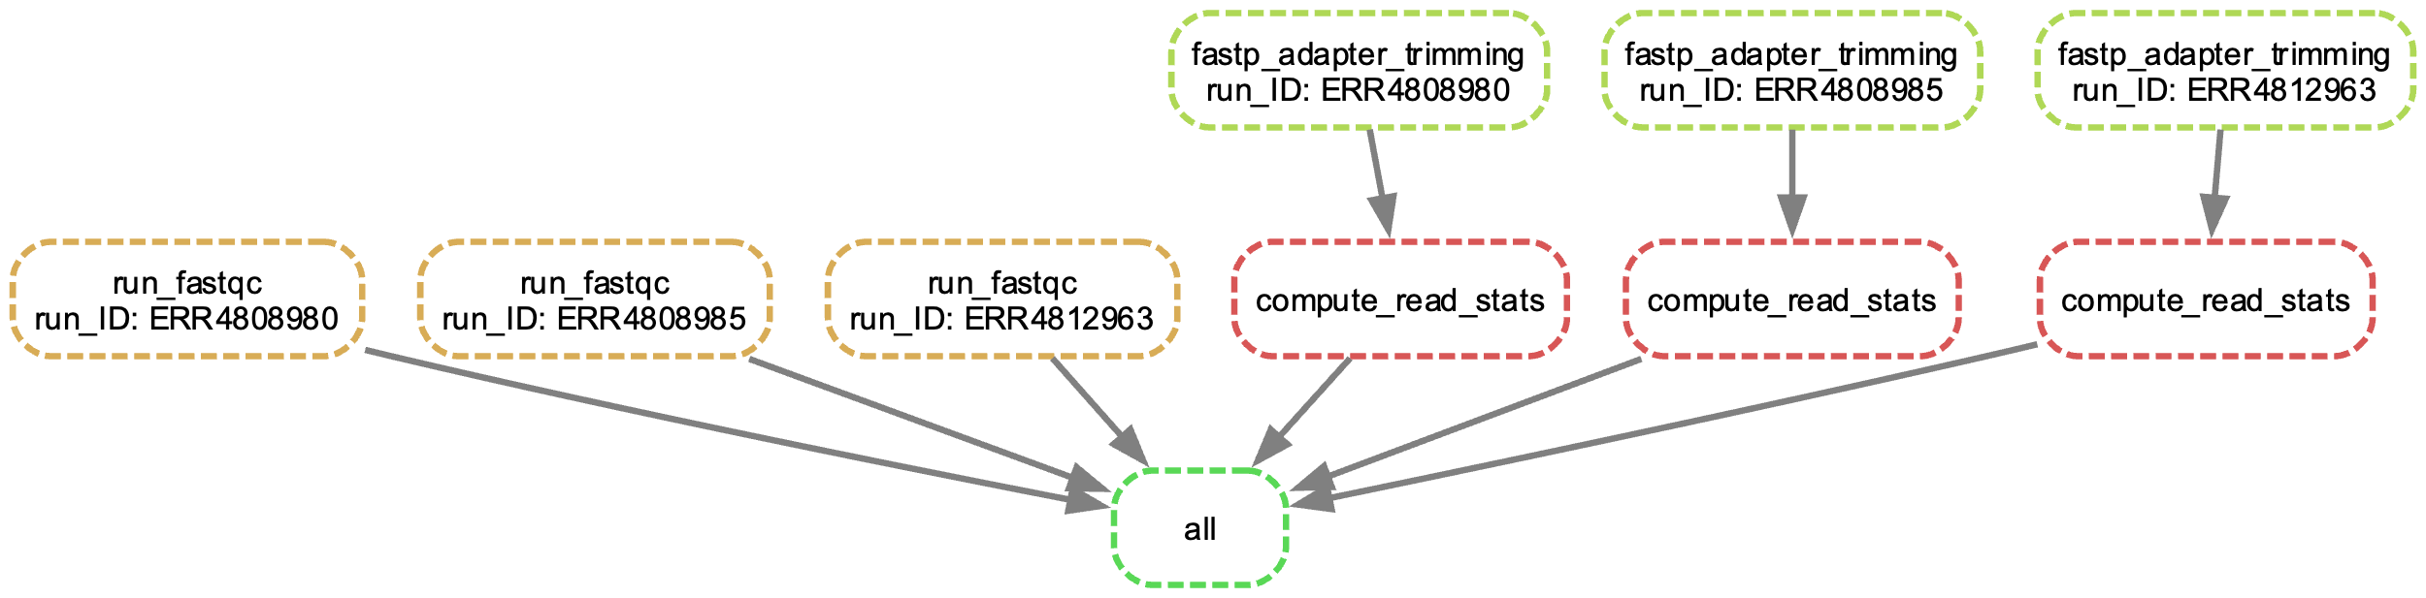
Directed Acyclic Graph of Jobs
The outputs of fastp_adapter_trimming are required for compute_read_stats.
run_fastqc is not dependent on any other rules.

Slide 27
Run the workflow

Slide 28
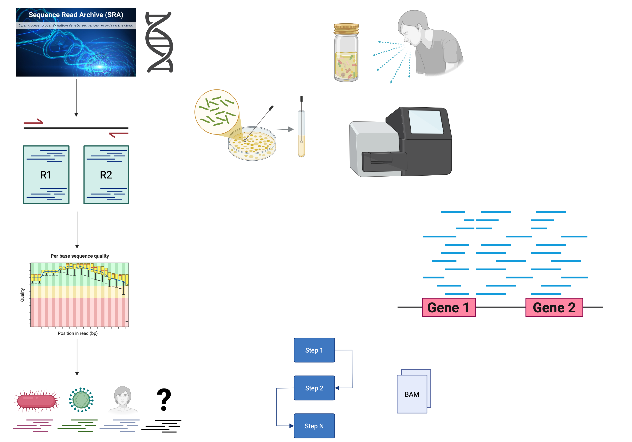
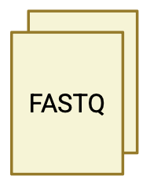
Write your own rule
Unclassified reads do not map with high enough confidence to any taxon in the database
Could be due to
Poor quality reads (incorrect nucleotides)
Too short or repetitive reads (insufficient unique k-mers to classify)
Something truly novel
Extract reads + quality scores

Slide 29
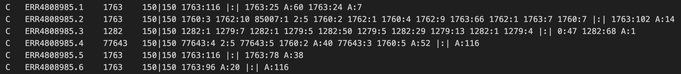
Kraken Classifications File Format
C/U Read Name TaxID Read Length Number of k-mers mapping to each TaxID
https://ccb.jhu.edu/software/kraken/MANUAL.html

